Slide 1
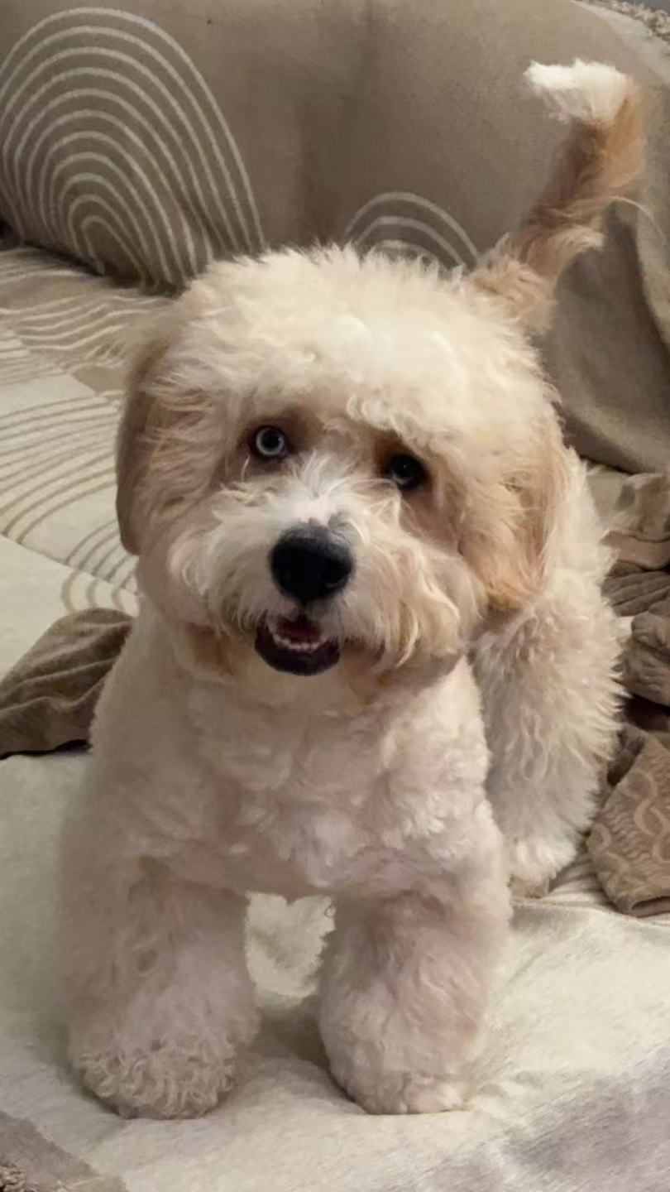
Doggo Dreams
– A website dedicated to providing customers with healthy, reliable dog purchasing and care information.
Let every dog find a happy home

Slide 2
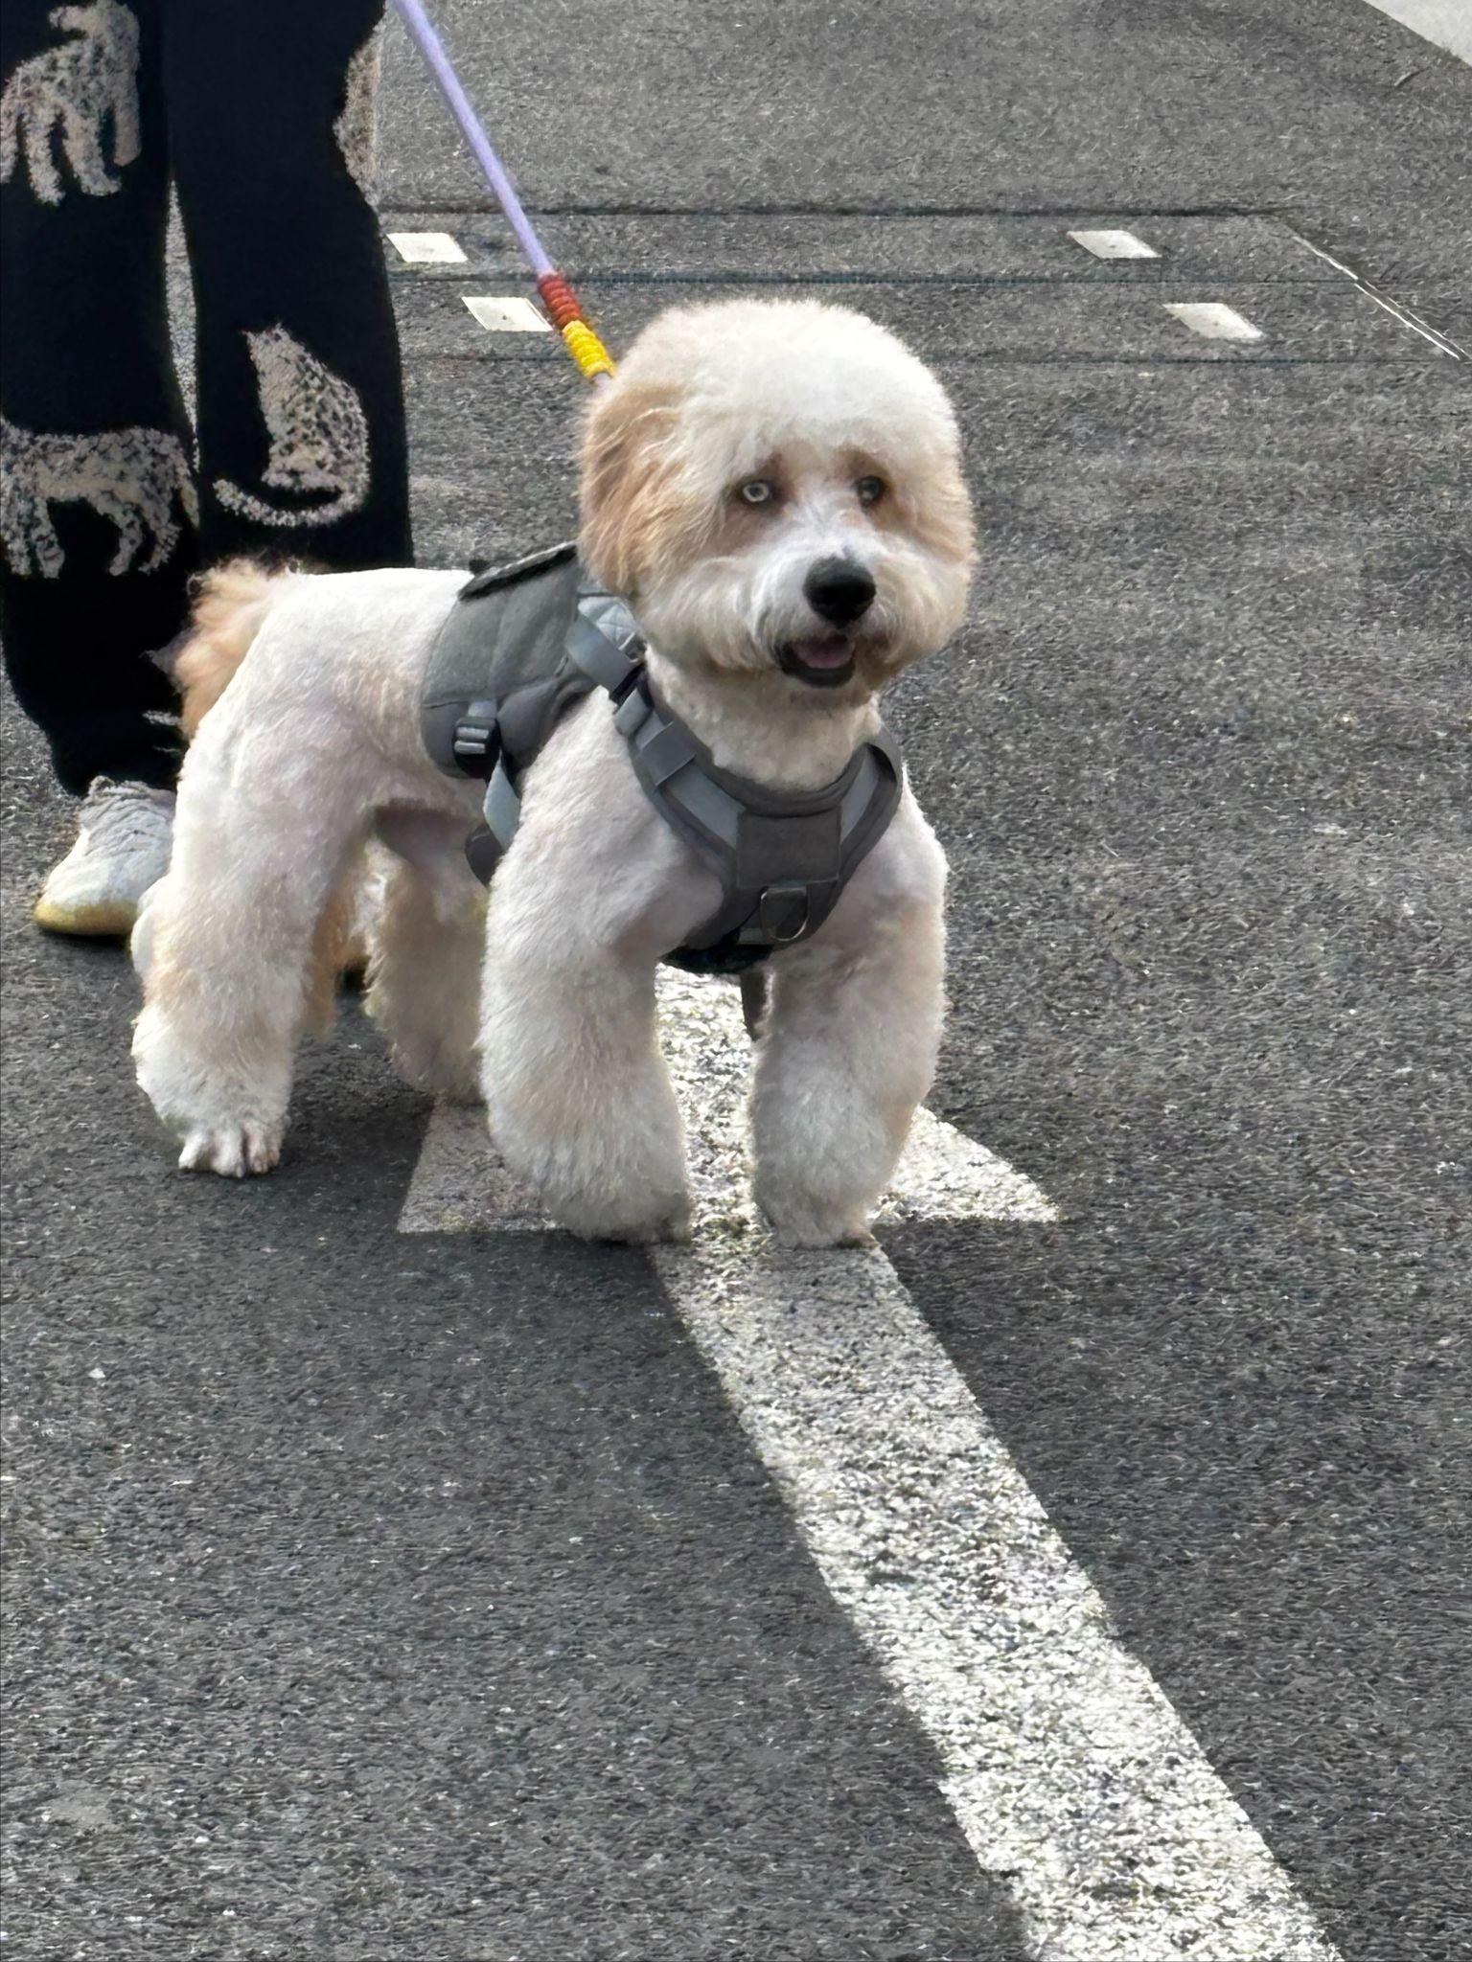
Project Goal / Target Audience
Website Features
– This website helps people find and buy healthy dogs while learning basic care tips
– We focus on families and pet lovers who want a simple online way to choose and care for dogs.
1) We offer filters to search by breed size, color, or temperament
2)We provide health records and vaccine details for each dog
3)We include easy training and feeding guides for new owners

Slide 3
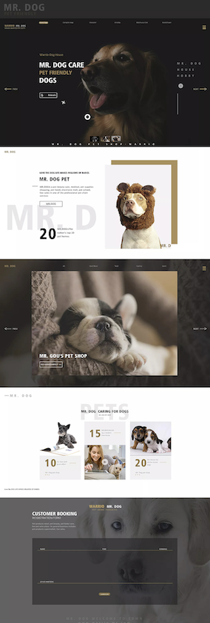
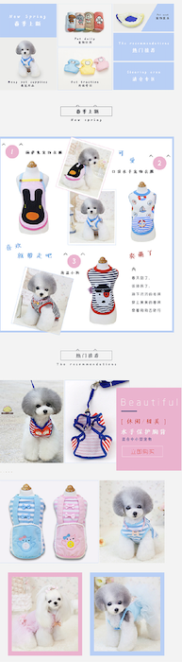

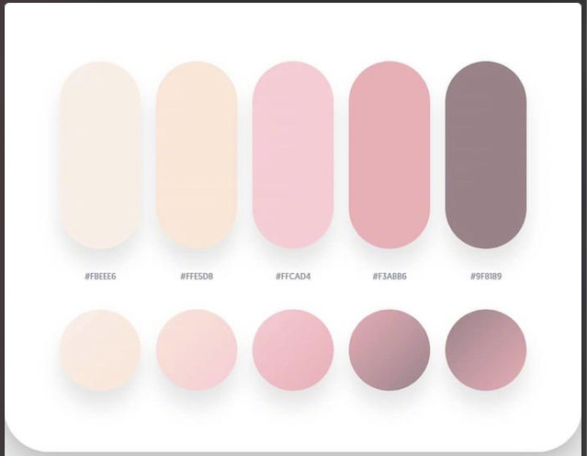
Mood board
Notes:
This mood board represents the overall look and feel of my dog-selling website. I chose a soft pastel color palette with playful and friendly design elements to create a warm and inviting experience for people looking to adopt or buy a dog.

Slide 4
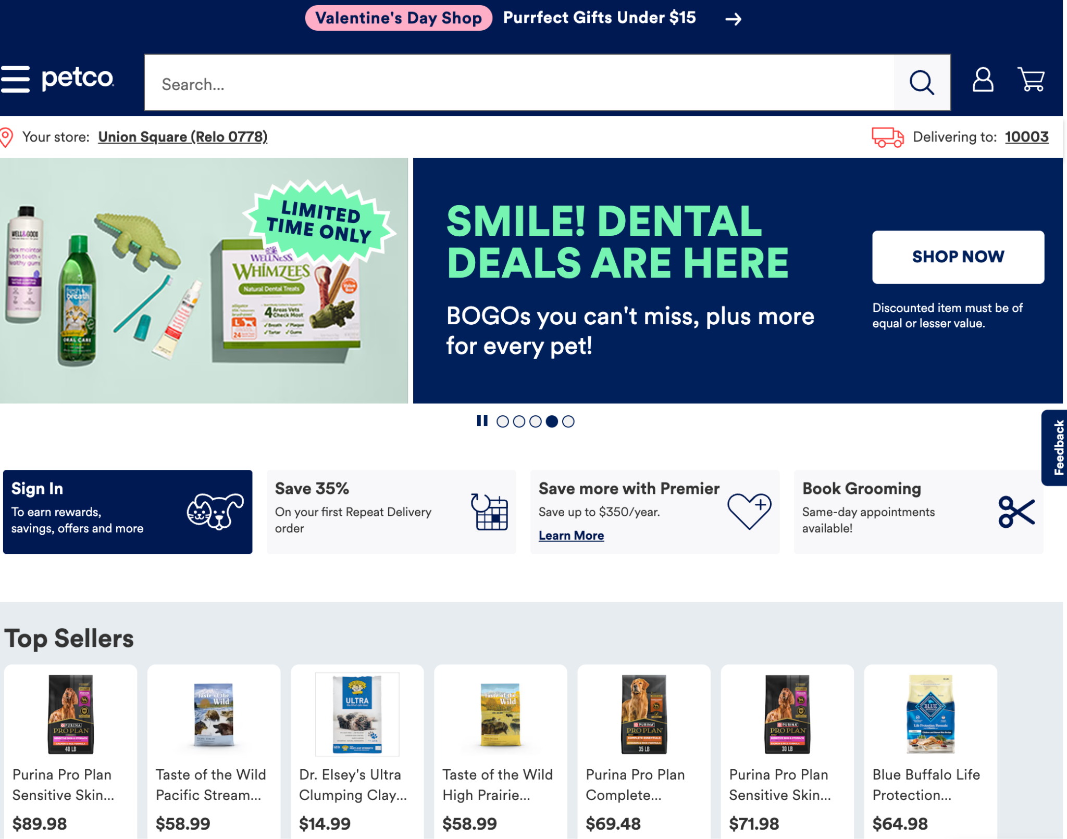
Reference Website Showcase(1)
Petco
Clear category navigation (dogs, cats, pet supplies), helping users quickly find what they need.
Uses warm, bright colors that highlight a friendly pet-focused theme.
Detailed product pages with an easy purchase process.
–petco.com

Slide 5
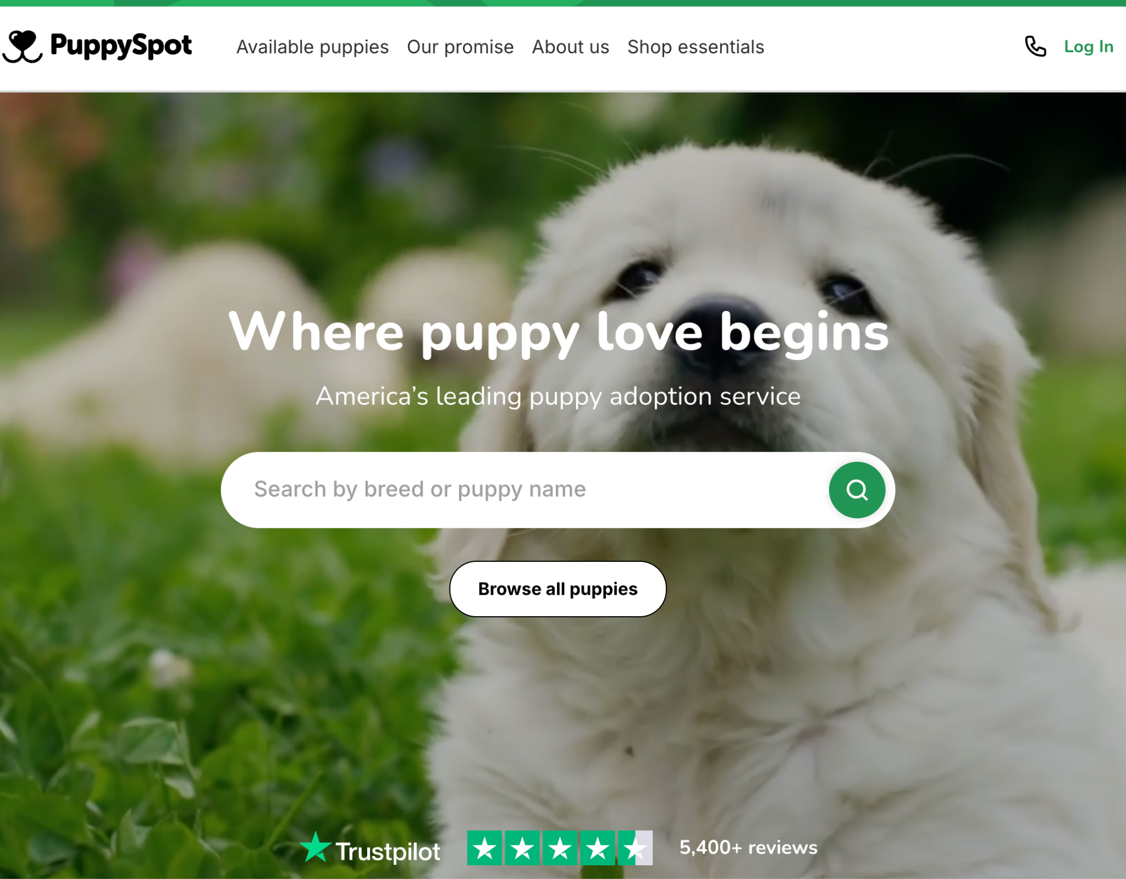
Reference Website Showcase(2)
• PuppySpot
Focuses on dog buying and adoption, offering a breed list and filtering function worth emulating.
Large dog photos create an immediate, heartwarming impression.
Emphasizes “health guarantees” and “professional breeders” to show reliable dog sources.

Slide 6
Key concepts we learned
HTML & CSS
Basics
Transforms and Filter
Layout
Images
How to add images
Semantic tags, box model, simple backgrounds
Flexbox for structure
Simple animations(rotate, scale…), Filters(gray, hover,smooth…)

Slide 7
Things I need to learn
Advanced Layout/
Animation/ Interaction:
CSS transitions & keyframe animations (e.g. image slider, hover scaling)
Make the website look better and learn about proportions
Search bar, breed filters, detail pop-ups, etc

Slide 8
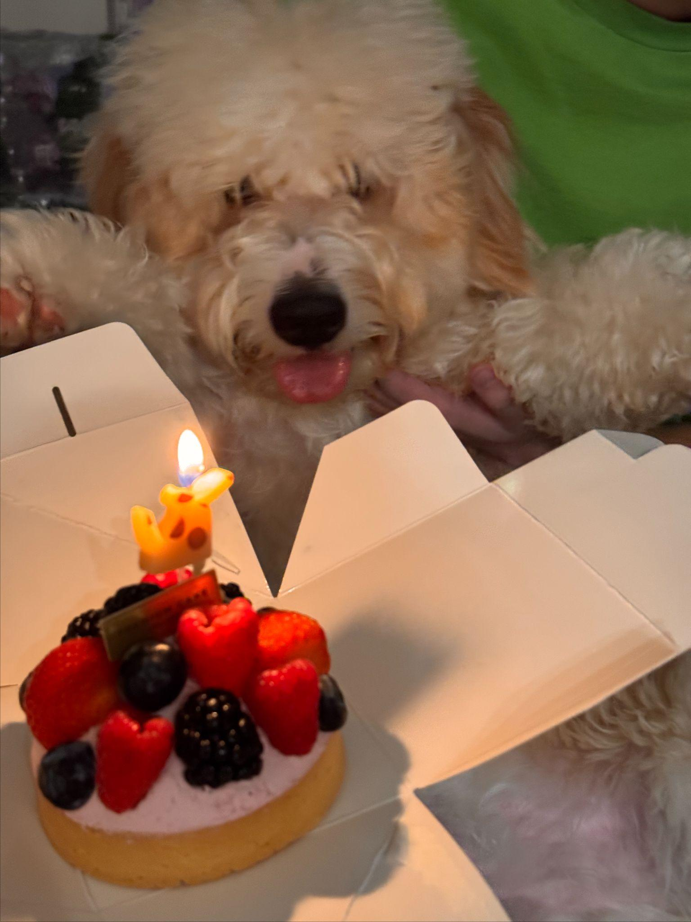
wireframe
Log
<img>
<h1> Doggo Dreams</h1>
<nav>Home Breeds Care Tips About Us Connect Us</nav>
Search Bar
<img>
<p>picture description</p>
<img>
<img>
<img>
More ifo
More ifo
More ifo

Slide 9
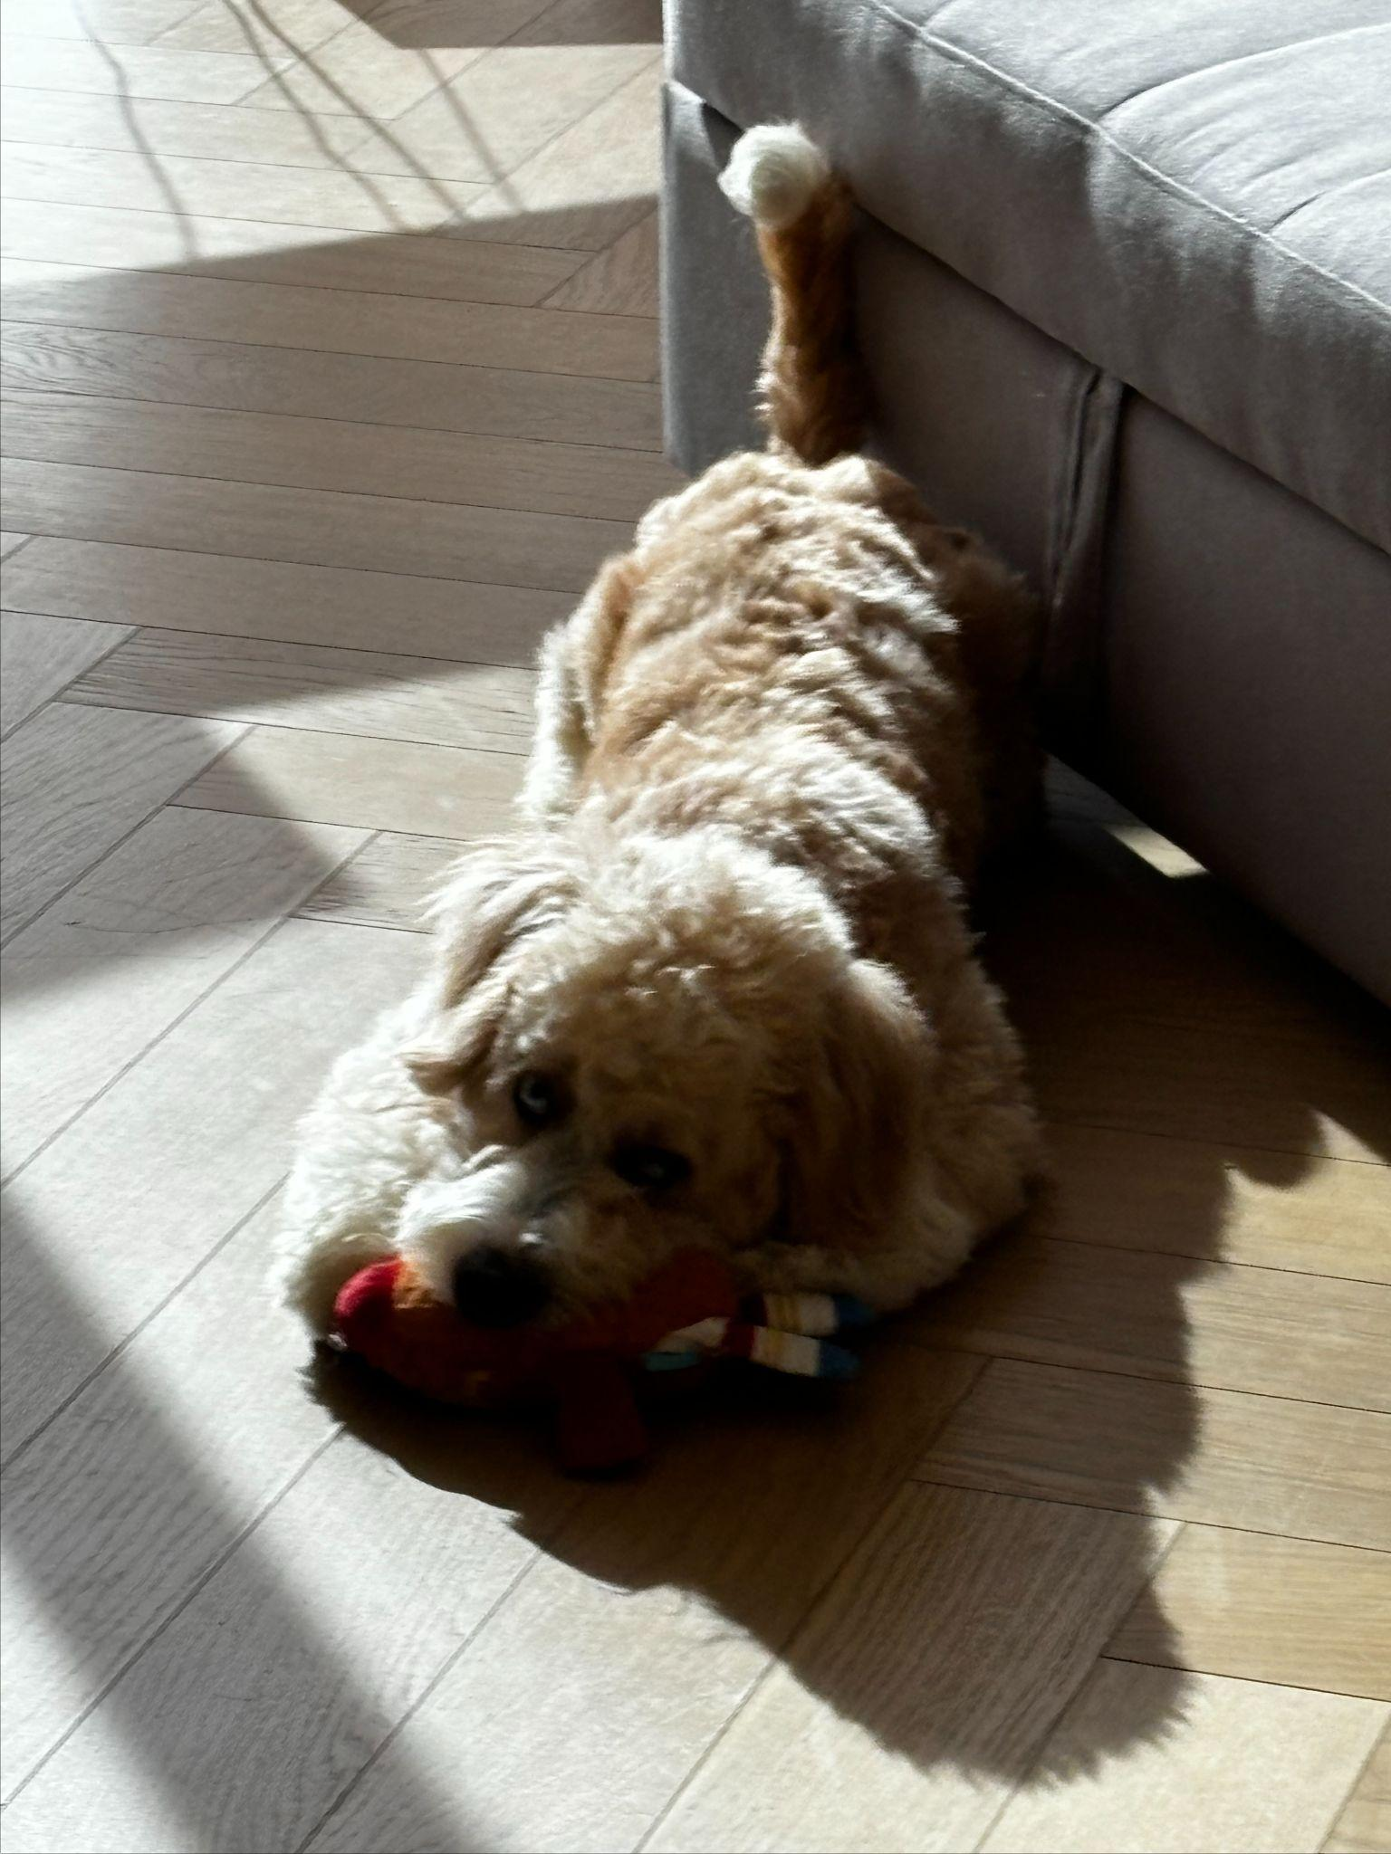
wireframe
Log
<img>
<h1> Doggo Dreams</h1>
<h2> Breeds </h2>
<img>
<p>
picture description</p>
<img>
<img>
<p>
picture description</p>
<img>
<p>
picture description</p>
<img>
<p>
picture description</p>
<p>
picture description</p>
<img>

Slide 10
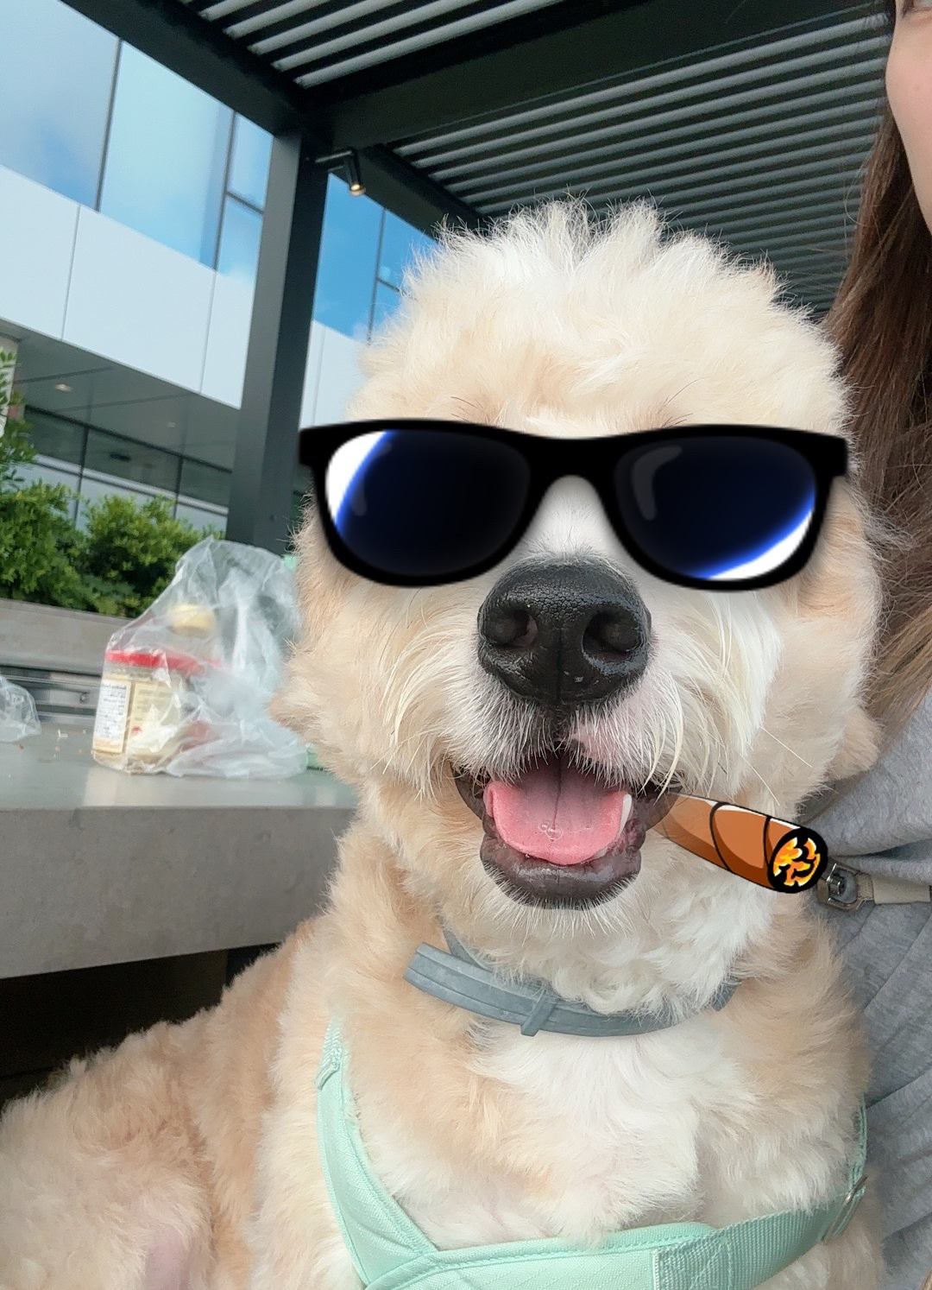
wireframe
Log
<img>
<h1> Doggo Dreams</h1>
<h2> Care Tips </h2>
<img>
<p>description</p>

Slide 11
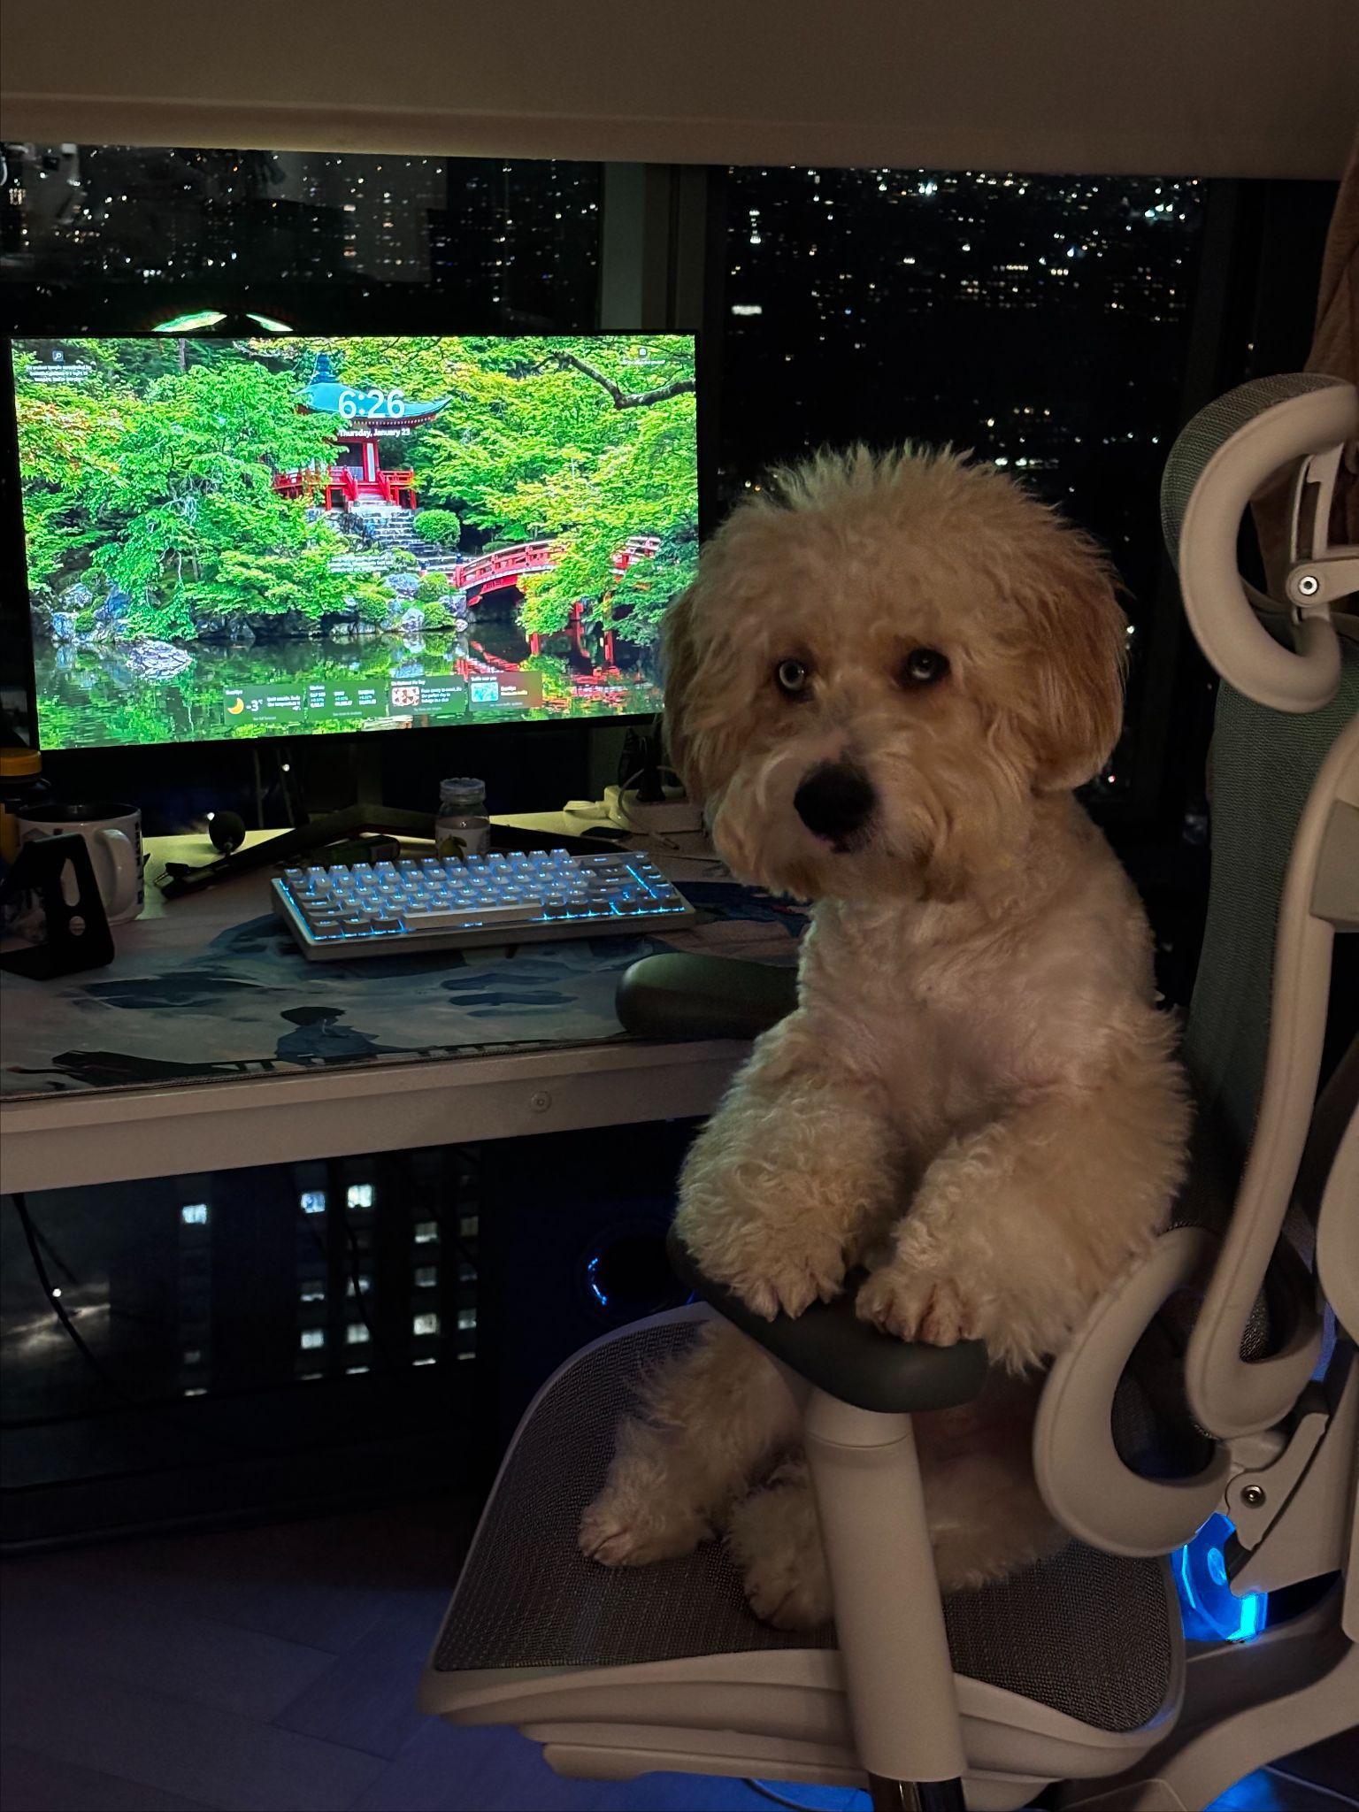
wireframe
Log
<img>
<h1> Doggo Dreams</h1>
<h2> About Us</h2>
<img>
<p>description</p>
<img>
<img>

Slide 12

wireframe
Log
<img>
<h1> Doggo Dreams</h1>
<h2> Connect Us</h2>
<p>description</p>
<footer>Social Media</footer>

Slide 13
Woof!
Thank you!

